Slide 1
Automation Using Python -Sikuli
PyCon India 2017 Presentation

Slide 2
Agenda
Python Sikuli Automation Overview | 3
Automation Framework | 4
Sikuli Overview | 5
Automation Modules | 6
Skype Automation -Demo | 7
Telematics System Test Automation -Insight | 8
Key Benefits | 9
Reference and Contact | 10

Slide 3
Python Sikuli Automation Overview
Why
Over come Challenges in Automation of Desktop App
Independent of DLL’s , API’s and Source code tags/elements
Analyse the image , maps , colour , text in the application
Perform OCR , image recognition and control mouse/key pad events.
What
Use best of Python-Sikuli for Automation
Python to be used as main automation script which would interact with automation environment
Sikuli is mainly used for image recognition and controlling the desktop events
Combined best of two open source language for creating Automation framework
Where
Desktop App Automation
Skype based Chat automation
Desktop Tool Automation
Bigger System Test Automation like Telematics , Embedded applications .

Slide 4
Automation Framework
Python
System to be automated
Sikuli
Xmlrpclib client -----Xmlrpclib server
Pyserial
Visa
Pyodbc
mysql
Xmlrpclib
Win32com
ctypes
Csv
Xml
Xlutil
Image reorganization
Mouse events
OCR & color identification
Image capture and store

Slide 5
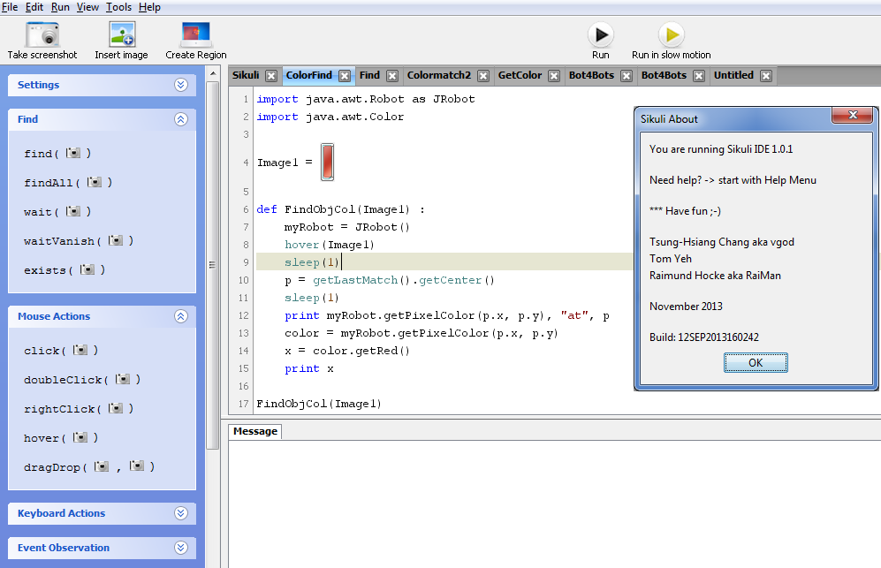
Sikuli Overview
Sikuli is an Open Source Visual technology to search and automate graphical user interfaces (GUI) developed by MIT
It is built using Jython hence has flexibility of importing java and python packages
Sikuli Scripts can be run on Windows/Linux/Mac OS X or even an iphone, android, application running in an emulator or running on a real device mirrored on a Test PC
Can automate Flash based web application
Supports key pad and mouse event automation
Sikuli Supports GUI automation base library class capable of scree n capture , button click , text entry , OCR , Color detection , size of the component etc
XML RPC Server client approach to invoke Sikuli scripts in Python
Generic Sikuli Automation library which can be re-used for any desktop web application testing

Slide 6

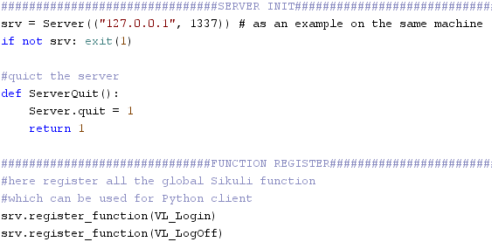
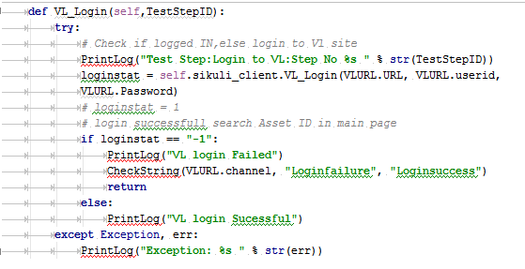
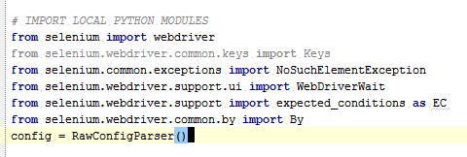
Automation Module
Sikuli Script
Sikuli Image Lib
Sikuli General Functions
Sikuli Scripts
Sikuli Server
Sikuli script
Sikuli XML RPC Server
PyQt –
GUI Interface for
Automation Configuration
Other Python
Modules
Xlrd-Xlutil
Python XML RPC client to invoke Sikuli scripts
Network Modules
Pytesser
Db Modules
Third Party Lib or Open Source Packages
Selenium
C DLL’s etc

Slide 7
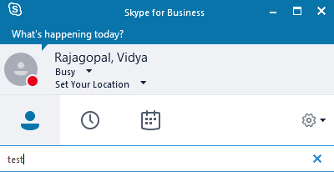
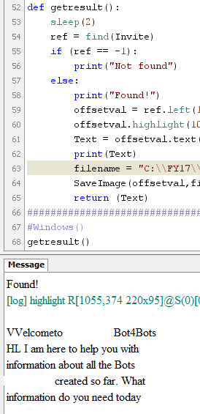
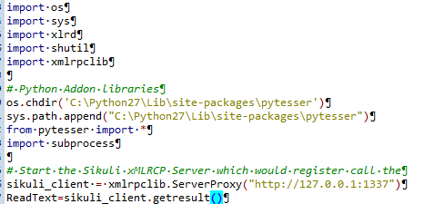
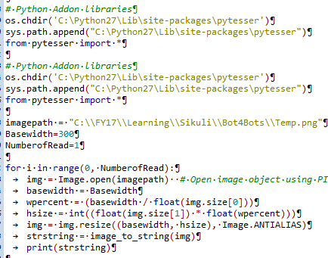
Skype Automation Demo
S
Sikuli
Python
Sikuli Images
Import
xmlrpclib
Xlutils
xlrd
Sikuli Functions
Xmlrpclib
Client and calling Sikuli function
Sikuli Server
Verification and Logging
Notes:
Note :
1 . Live demo of Skype Automation .
2. Various other Skype automation tried and could not succeed
https://pypi.python.org/pypi/Skype4Py/
https://github.com/Skype4Py/Skype4Py
https://opensourcehacker.com/2013/03/28/building-chat-applications-and-robots-for-skype/
http://stackoverflow.com/questions/4536146/need-an-python-script-that-uses-skype4py-to-send-an-instant-message
http://skype4py.sourceforge.net/doc/html/

Slide 8
Telematics System Test Automation – Insight
Telematics user Apps
Telematics BackOffice Apps
Telematics ECU
Web App
Mobile App
PyQT
win32com
Pyserial
Visa
Ctypes
Web interface
Mobile Interface
Xml
Xlutil -Xlrd-Xlwt
Csv
Pyodbc
Configparser etc
Selenium web driver
Sikuli script and server
Python sikuli client
Screencast etc
Pytesser / PIL

Slide 9
Key Benefits
Desktop tool
Image Recognition/ pattern matching/Color Verification
Open Source Automation Framework
Embedded
App
Web App
No need for Dll/API/Elements/Tags
Can Automate any Desktop Application
Best of Python-Sikuli for Automation
Easy to Script and Maintain
Mobile apps
Process
Automation

Slide 10
Reference and Contact
https://github.com/sikuli/sikuli
https://launchpad.net/sikuli/+download
http://sikuli.org/docx/
http://sikulix-2014.readthedocs.io/en/latest/index.html
https://docs.python.org/3/library/xmlrpc.server.html
Speaker Bio
Has over 14 year of experience in automotive domain in the field of automation, Model based design and development, IOT, Robotics, AI and quality management. Extensively worked on Automation of Telematics, IVI, Power train systems using some of the industry standard simulators and Automation languages apart from Model based design and development of embedded applications. Has extensively worked in open source automation language like python-sikuli-selenium-appium etc and built multiple automation assets for Automotive , IOT and Chatbots. Has two patents to her name in automation of Voice and Dbus based system test automation. Has published multiple white papers and blogs on Automation.
Contact : Vidya9425@gmail.com /Vidya.rajagopal@Accenture.com

